Slide 1
Digital resources in Intro Stats
Michael Sullivan
sullystats@gmail.com
Michael.Sullivan@fsw.edu
https://www.sullystats.com

Slide 2
Agenda
Securing Data
Existing Data
Surveys
Learning Catalytics
https://sullystats.github.io/Data/JSM2024.pptx

Slide 3
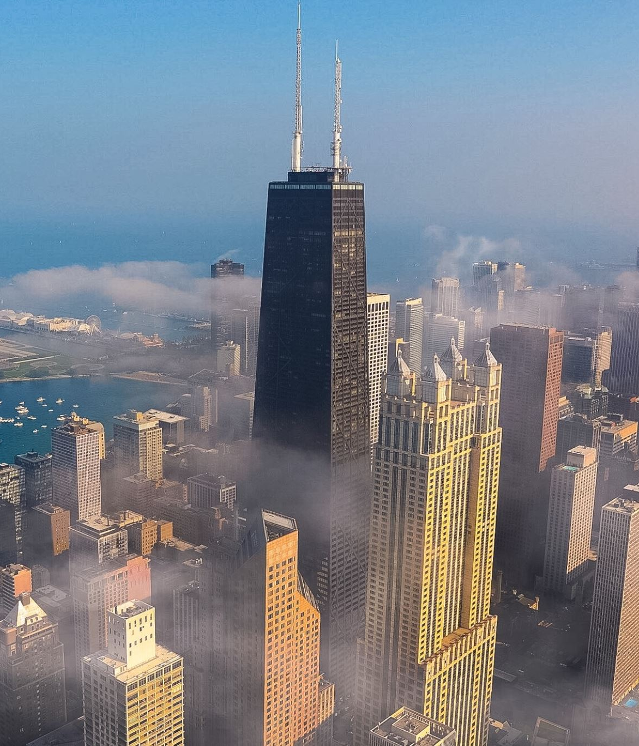
City of Chicago Data Portal
https://data.cityofchicago.org/

Slide 4
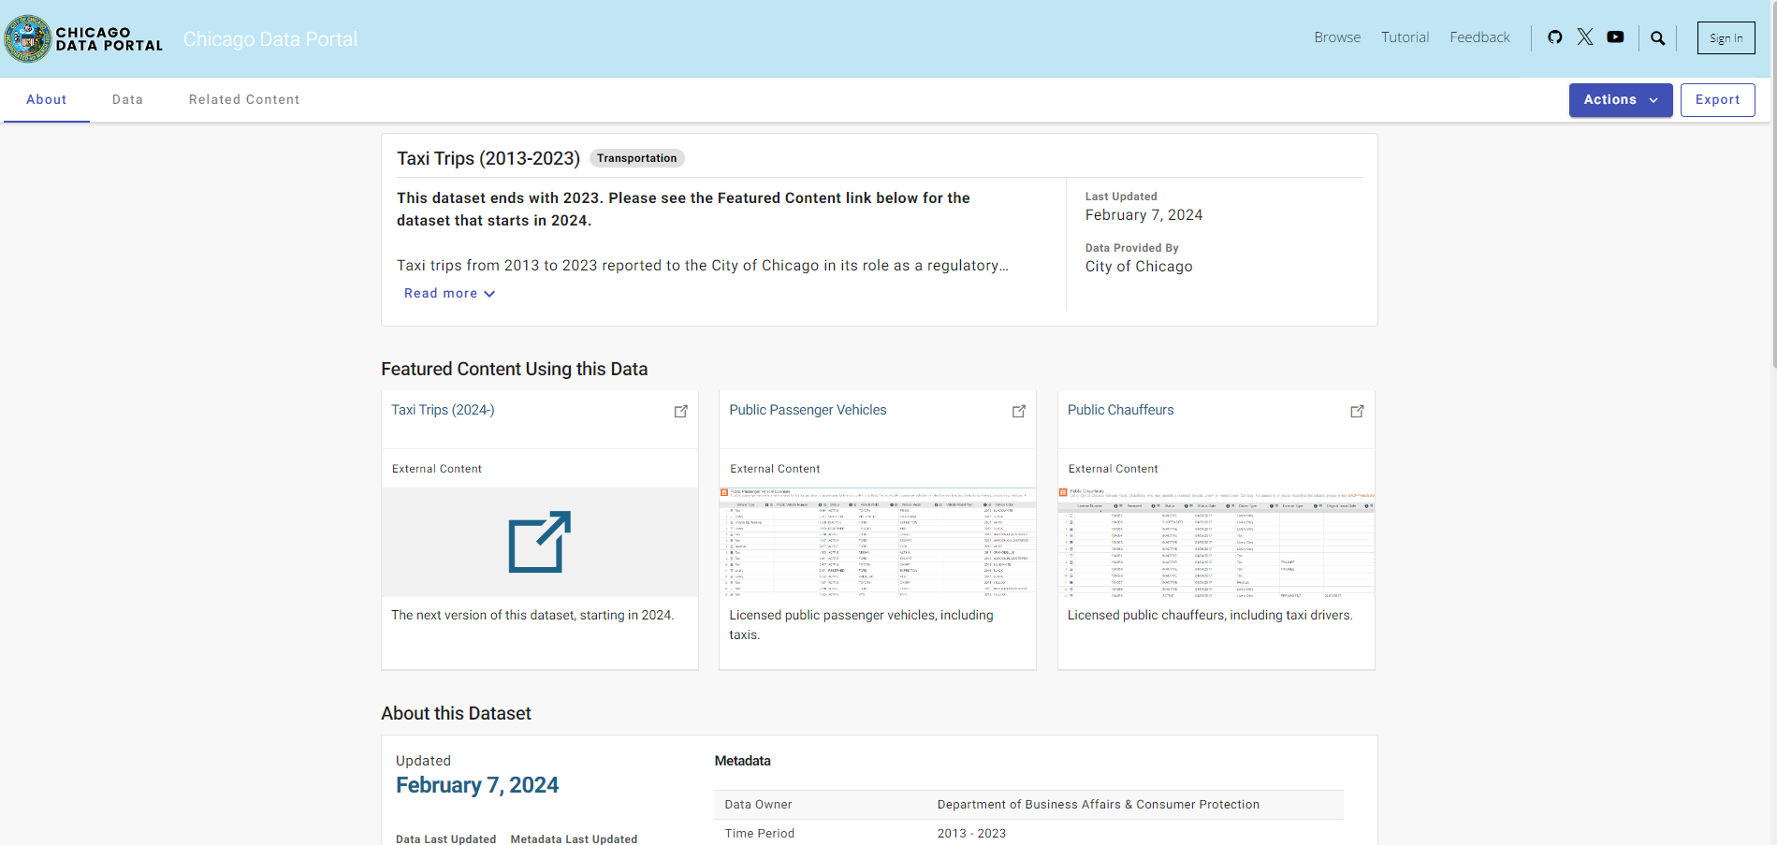
Notes:
Select Actions > Query Data

Slide 5
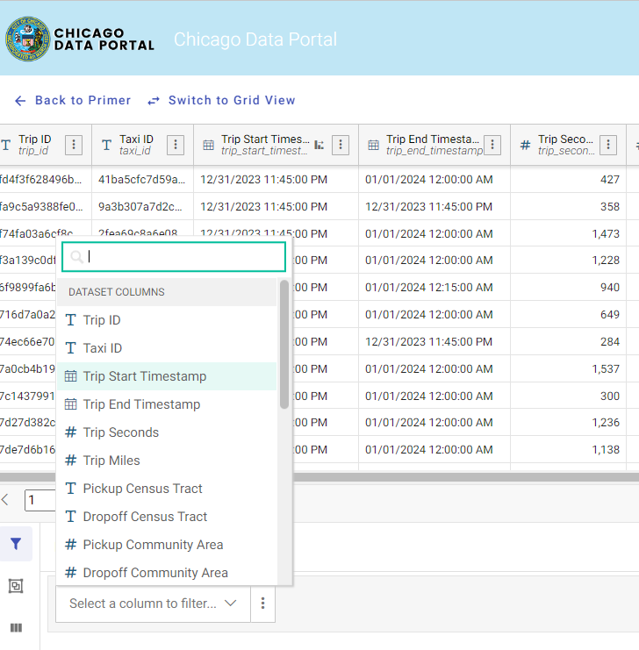
Notes:
Select a column to filter… Choose Trip Start Timestamp

Slide 6
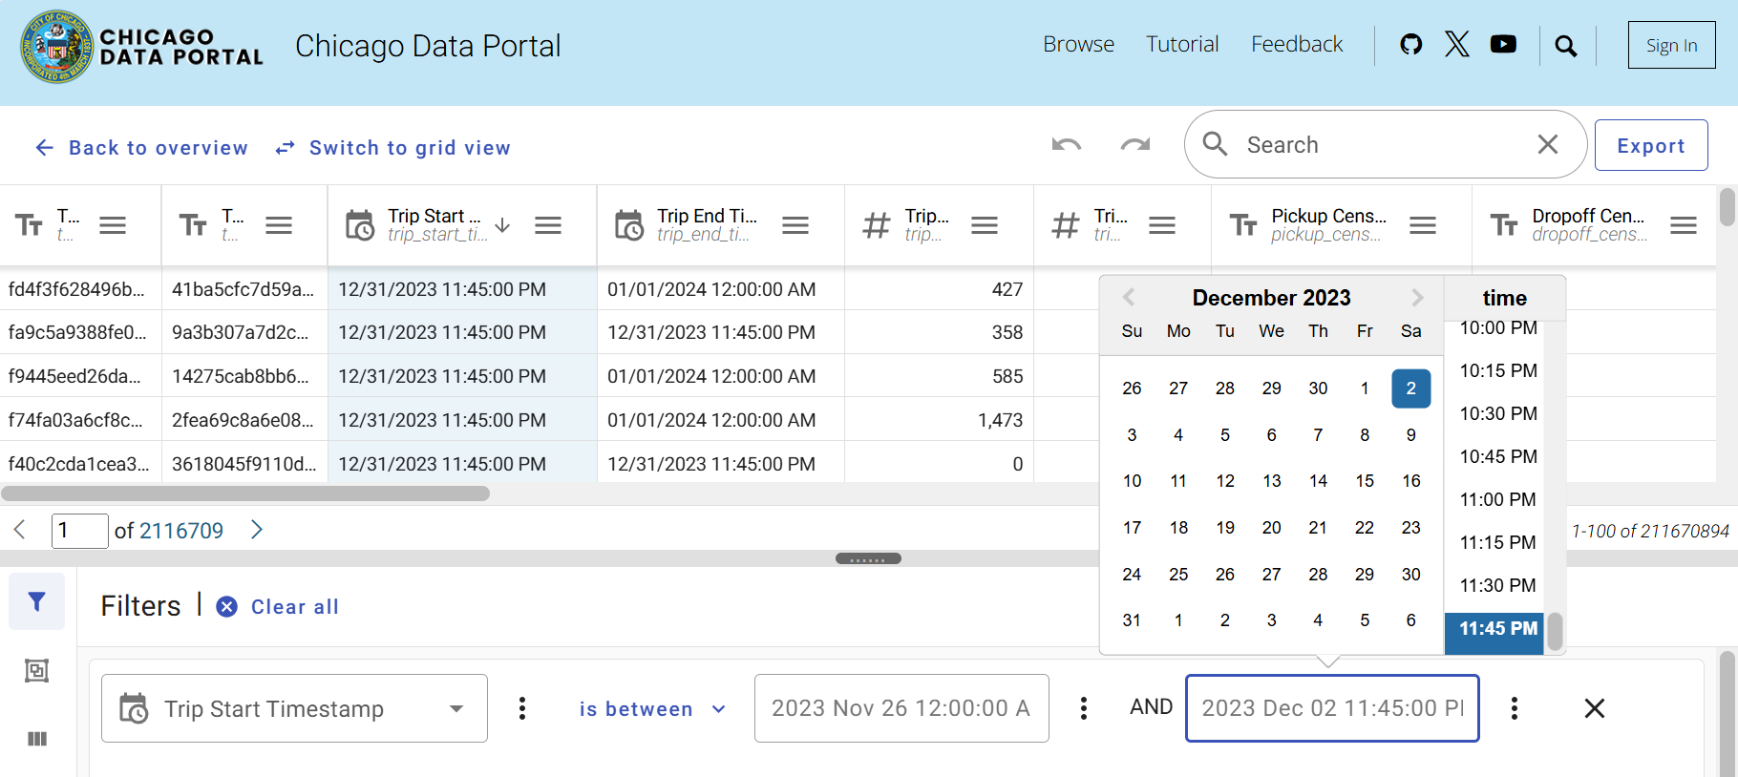

Slide 7
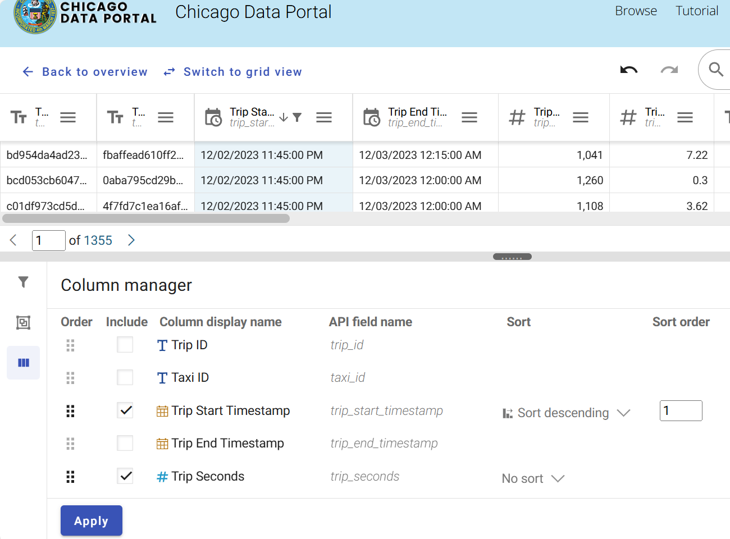
Notes:
Select the Column manager. Select the variables to be included. Click Apply

Slide 8
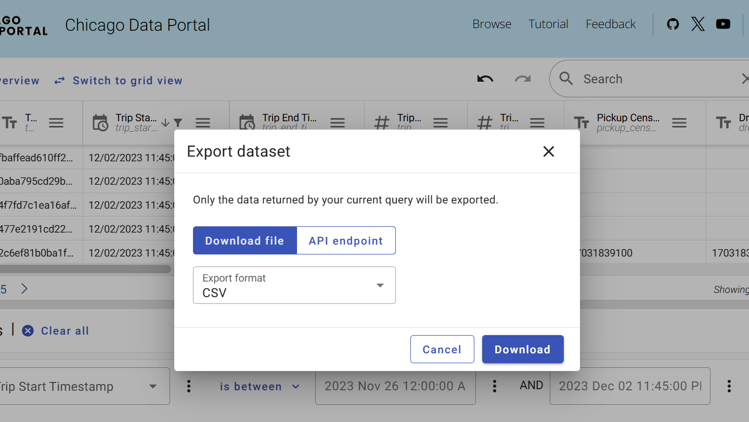

Slide 9
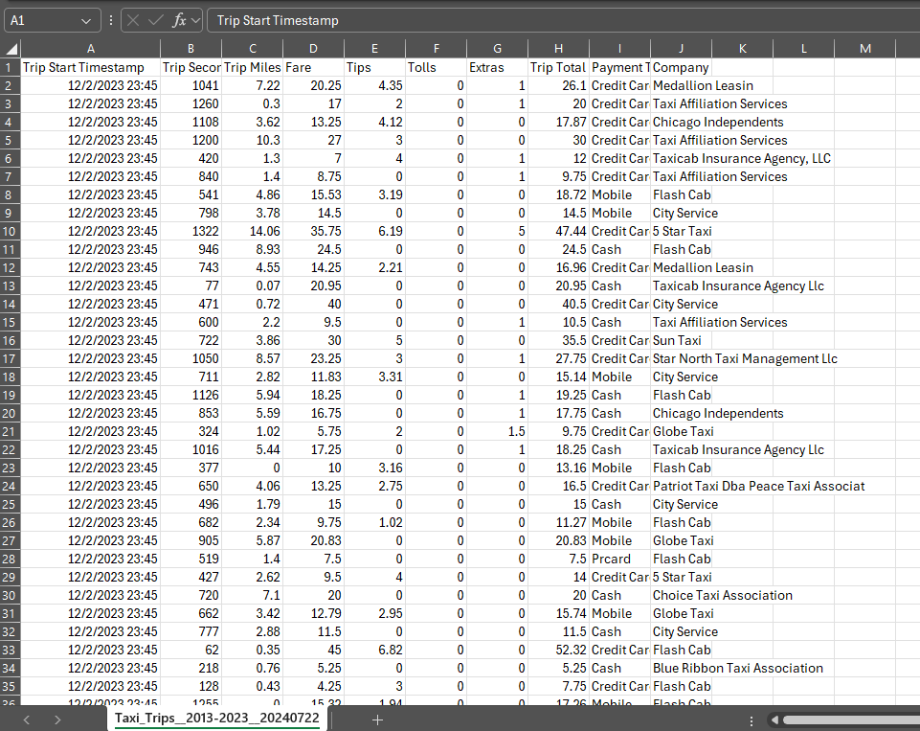
Notes:
Open the file in Excel to preview data frame.

Slide 10
The raw data is available at
https://sullystats.github.io/Data/Taxi_Trips.csv

Slide 11
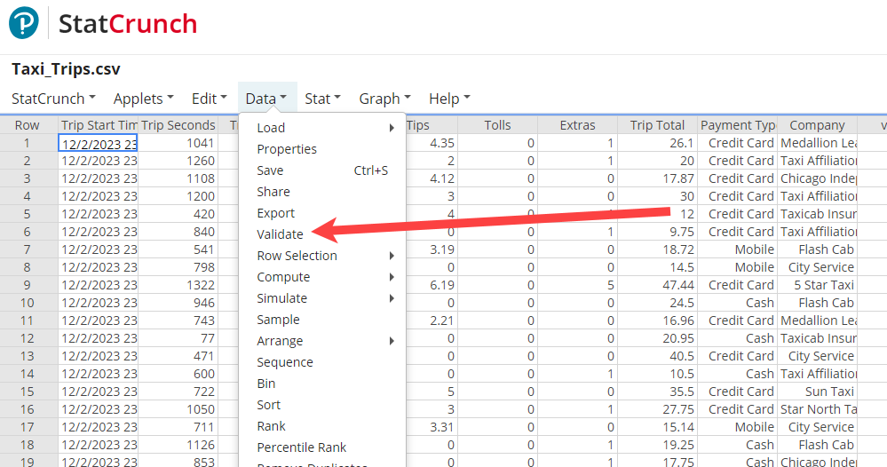
Notes:
Now, we will validate the data to identify missing empty cells. Select Data > Validate

Slide 12
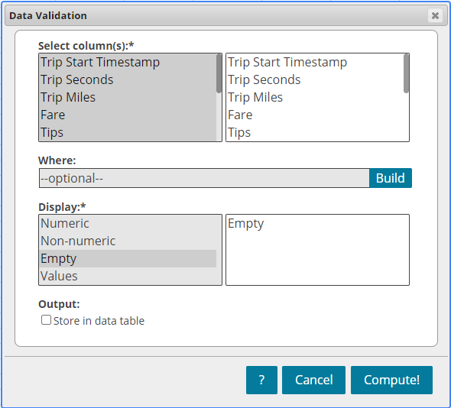

Slide 13
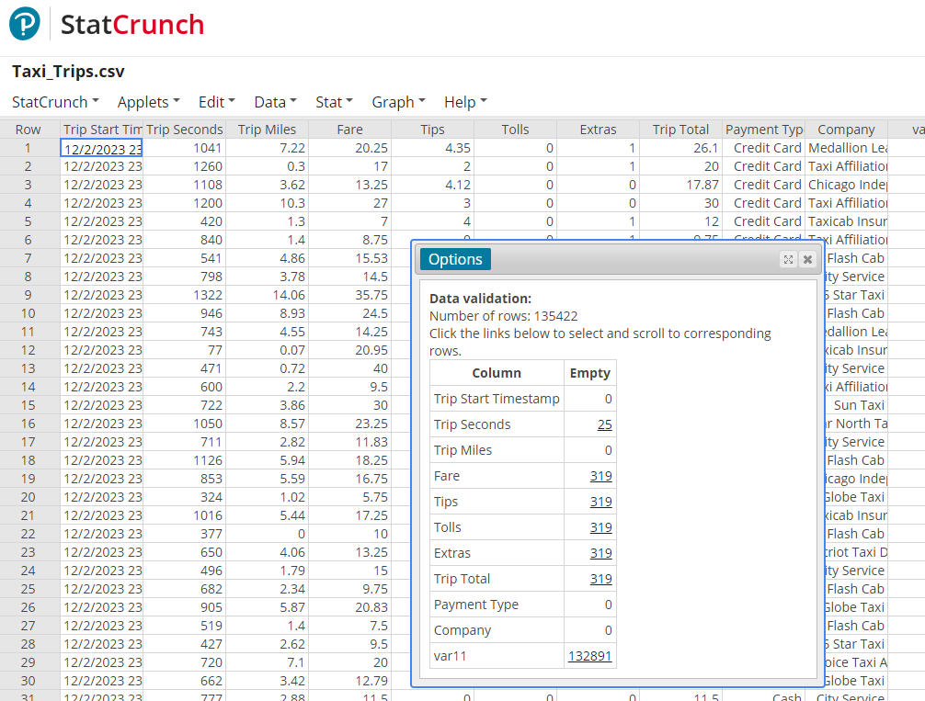
Notes:
There are 319 rows where the Fare, Tips, …, Trip Total are empty. We will choose to remove those observations from the data frame. To do so, click on the 319 to highlight the rows with the empty cells.

Slide 14
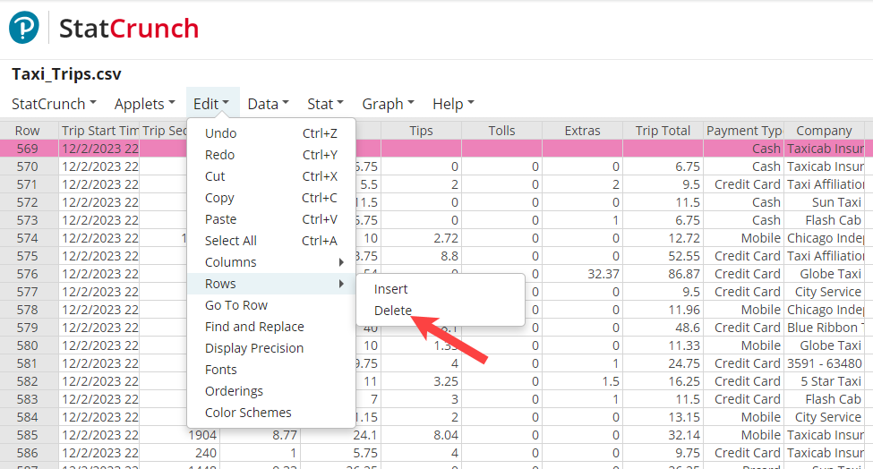

Slide 15
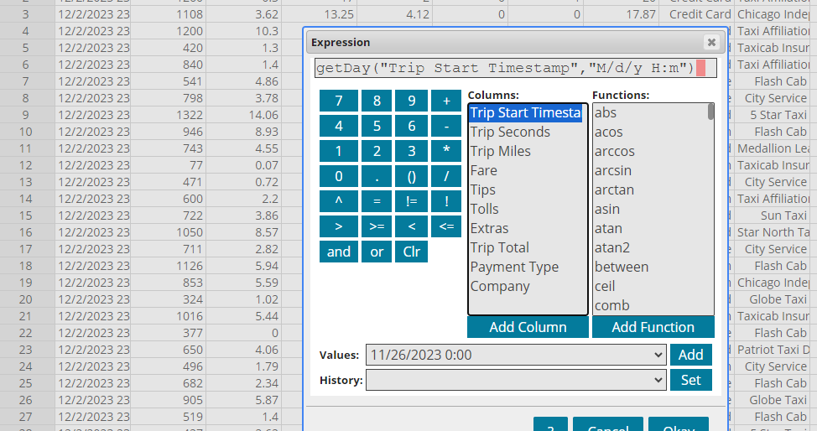
Notes:
Let’s build a new variable using StatCrunch. Here we are creating a variable for day of the week in which the trip began.

Slide 16
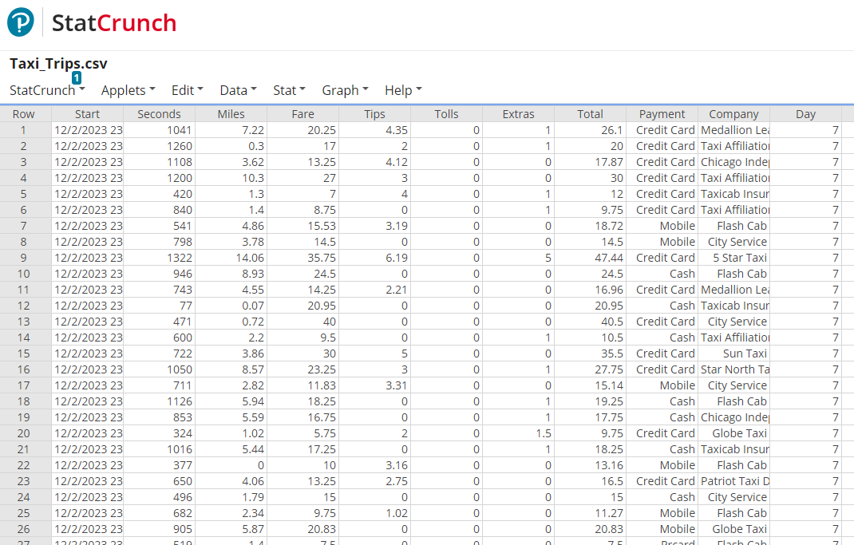
https://sullystats.github.io/Data/Taxi_Trips_edited.csv
Notes:
Note that 1 = Sunday, 2 = Monday, and so on.

Slide 17

Statcrunchthis!
https://www.youtube.com/watch?v=OtZsJllnaQ0

Slide 18
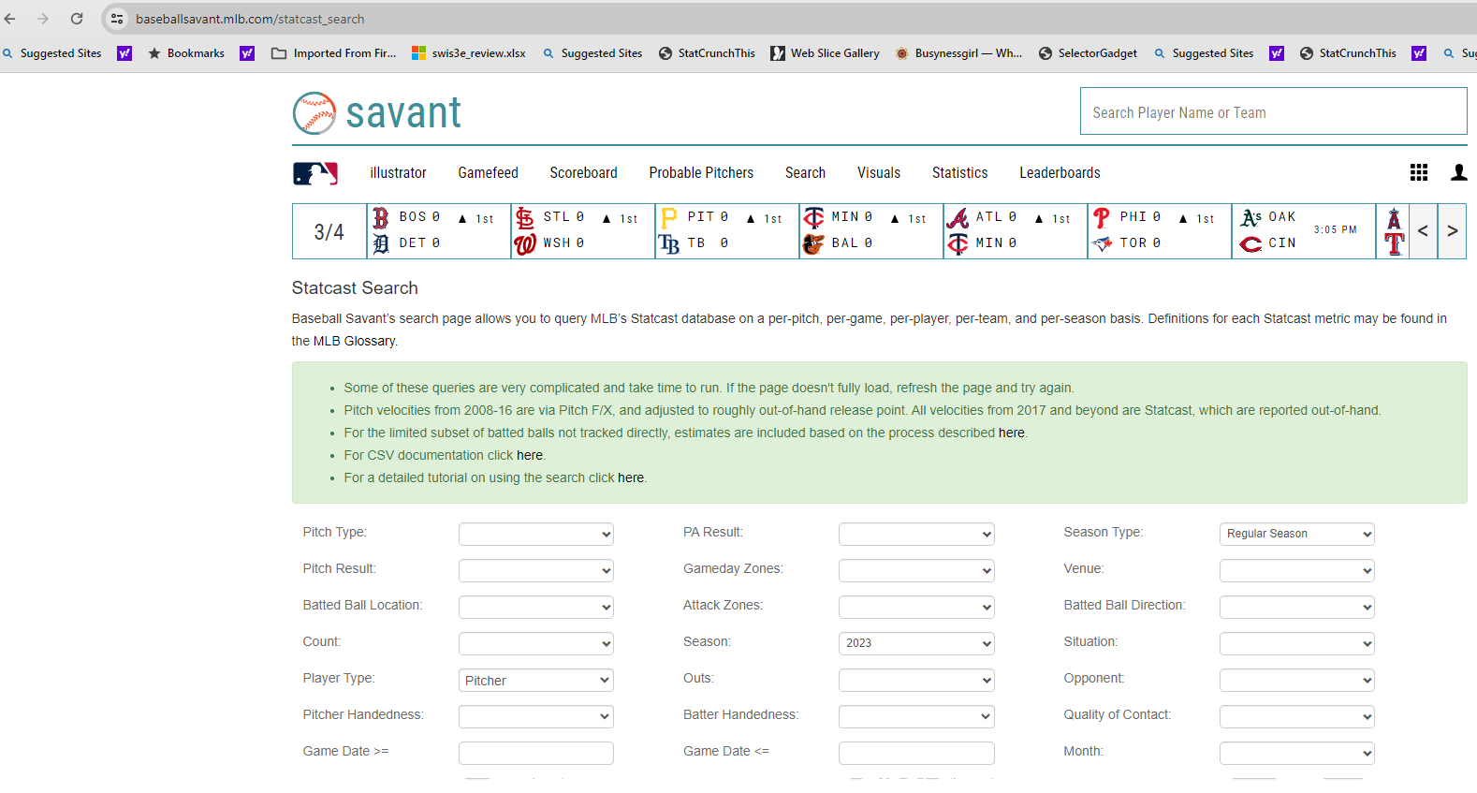
Baseballsavant.mlb.com/statcast_Search

Slide 19
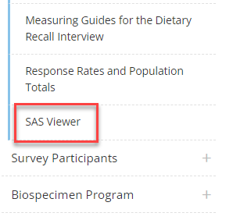
SAS Viewer
cdc.gov/nchs/nhanes/
Notes:
From the NHANES website, scroll down to the SAS Viewer. Click on the SAS Viewer link. Scroll to download the free SAS viewer. Download the latest version. You will need to create a profile on their website. Click setup after extracting the zip folder.

Slide 20
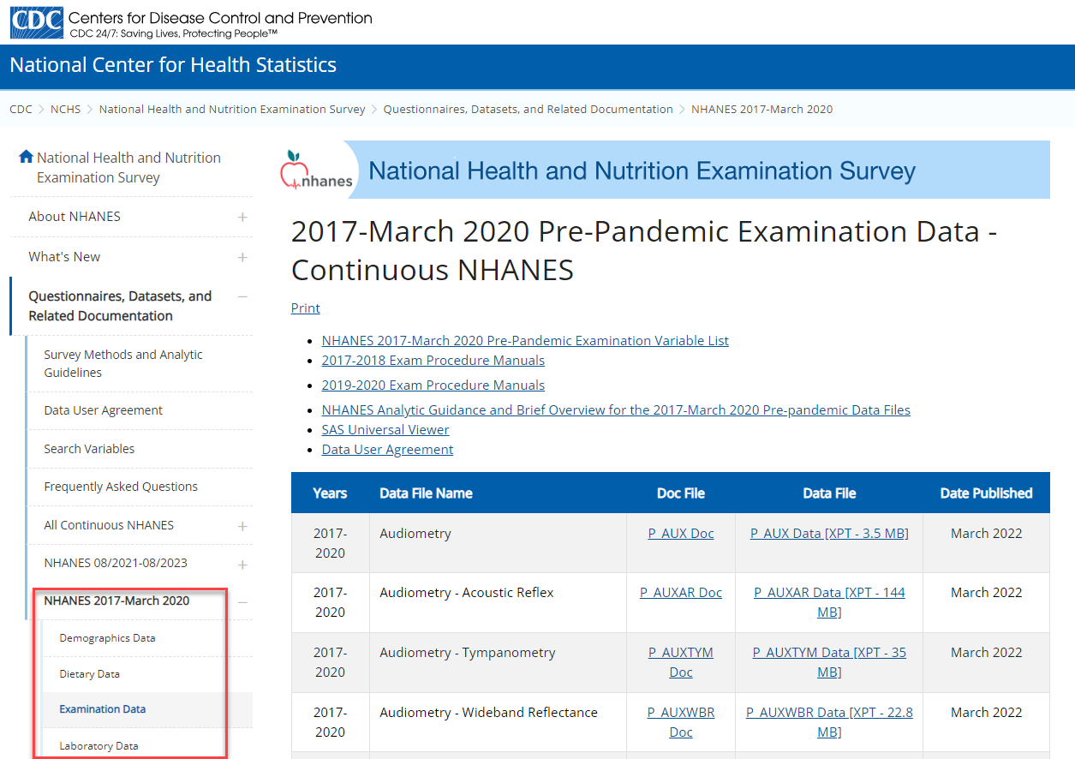
Centers for disease control and prevention (CDC)
wwwn.cdc.gov/Nchs/Nhanes/
Notes:
Select the 2017-March 2020 Pre-pandemic survey. We are going to obtain the demographic data, dietary data (dietary interview-total nutrient intakes, first day), and examination data (body measures).

Slide 21
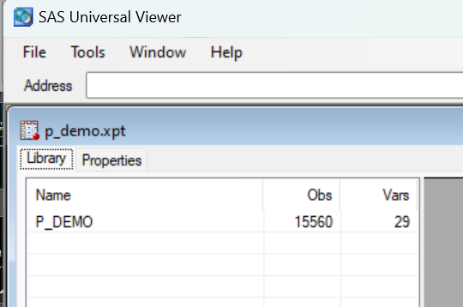
P_DEMO.xpt
Notes:
Double-click the P_DEMO.XPT file.

Slide 22
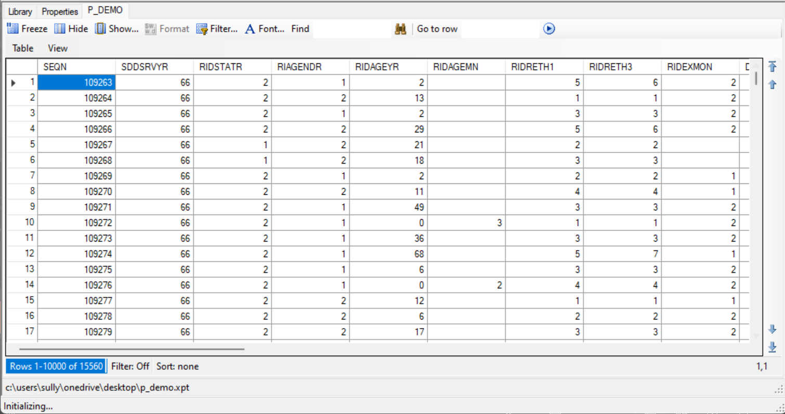
Notes:
Click Table

Slide 23
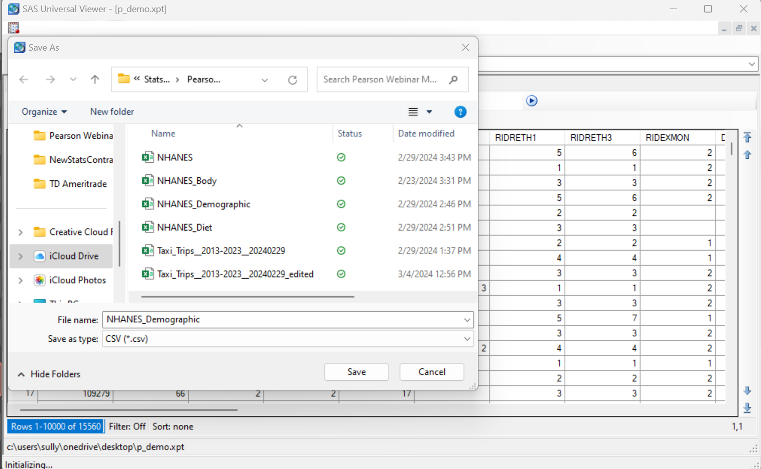
Notes:
Click Table > Save as and set type to CSV. Give the file a name such as NHANES_Demographic Repeat this for the other XPT files.

Slide 24
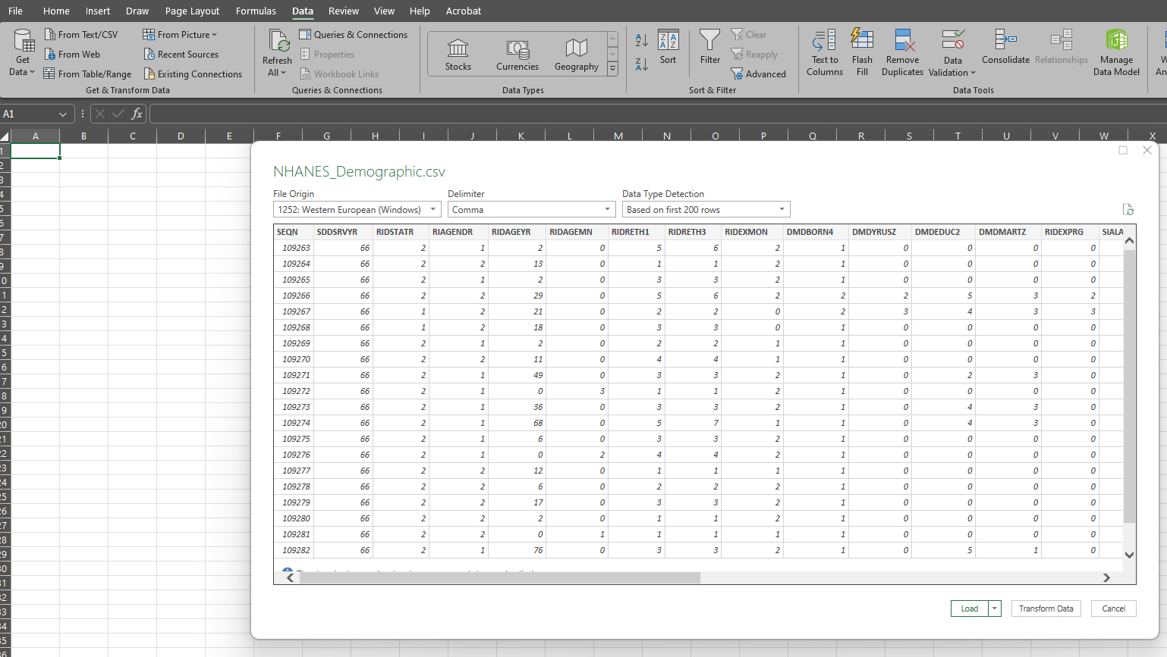
Notes:
Select Data > Get Data > From File > From Text/CSV. Select Demographic csv file. Click Load to…

Slide 25
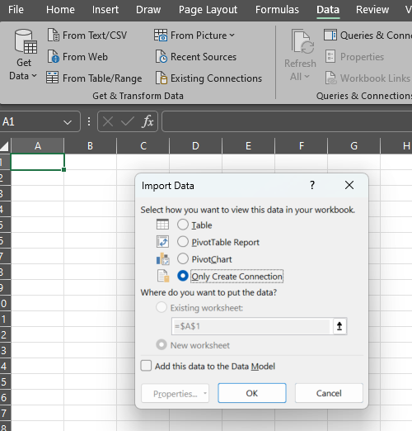
Notes:
Choose “Only Create Connection”.

Slide 26
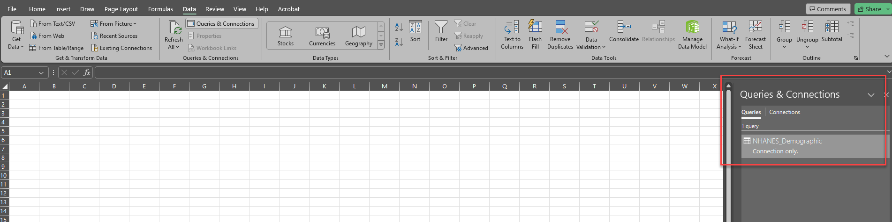
Notes:
Notice the NHANES_Demographic data appears as a connection only.

Slide 27
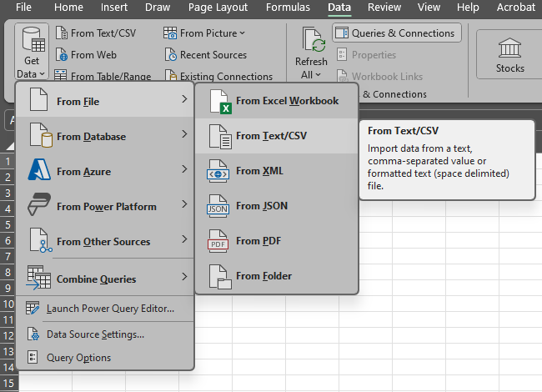
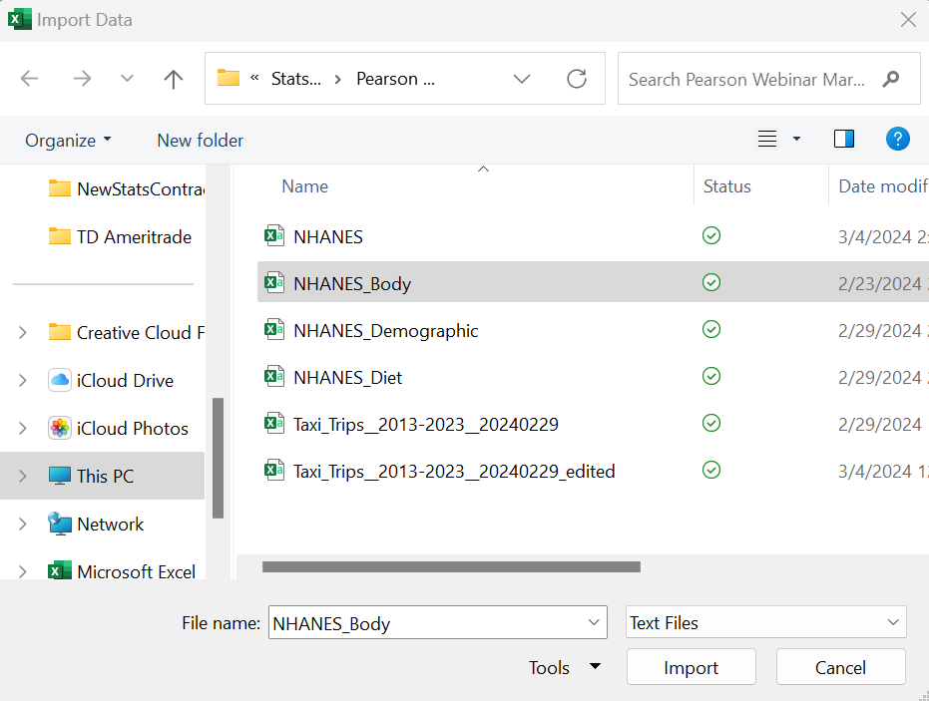
Notes:
Now select Data > Get Data > From File > From Text/CSV Select the NHANES_Body file

Slide 28
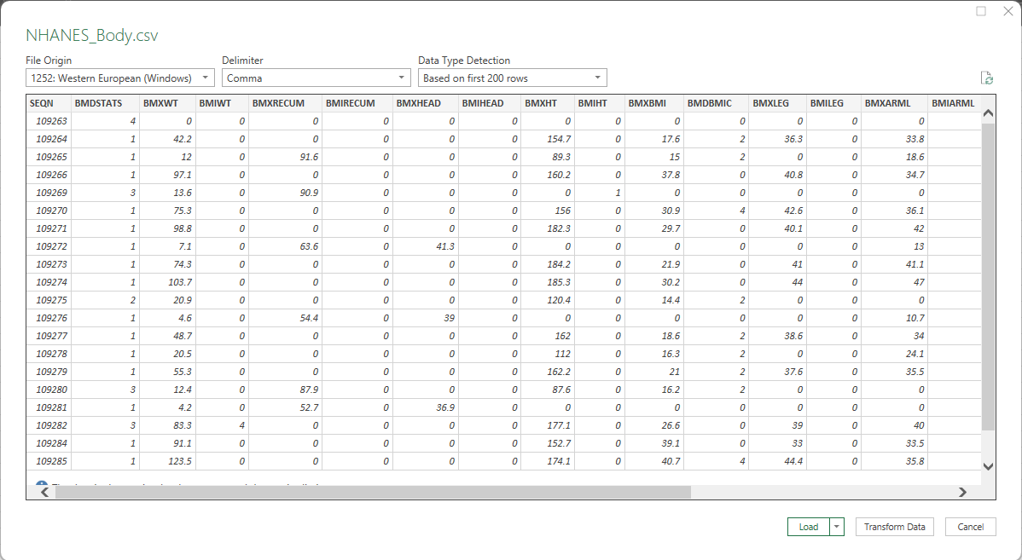
Notes:
Select Load to…

Slide 29
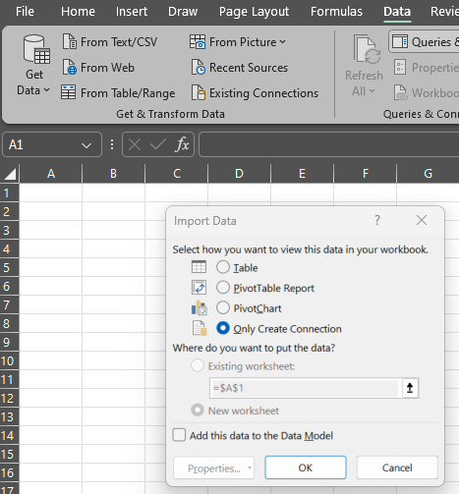
Notes:
Choose “Only Create Connection” click OK. Repeat this for the Diet data.

Slide 30
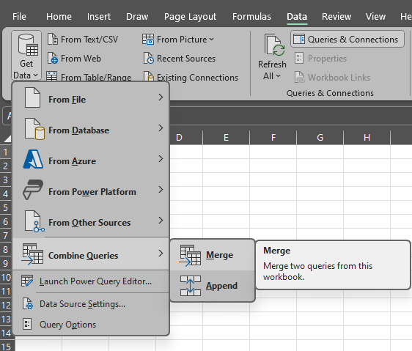
Notes:
Now we want to merge the files into a single file. We will do this in two stages. First, we will merge the Demographic data with the Body data. Once that is complete, we will merge the Diet data into the merged data frame.
Select Data > Get Data > Combine Queries > Merge

Slide 31
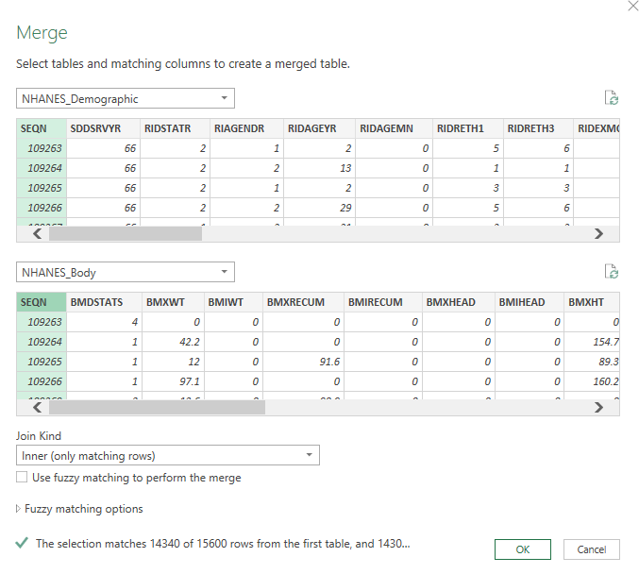
Notes:
We will merge by SEQN, which is the number associated with each study participant. Select “Inner” under Join Kind so we only grab the matching rows. Notice that 14340 of the 15600 rows in Demographic data frame match. Click OK.

Slide 32
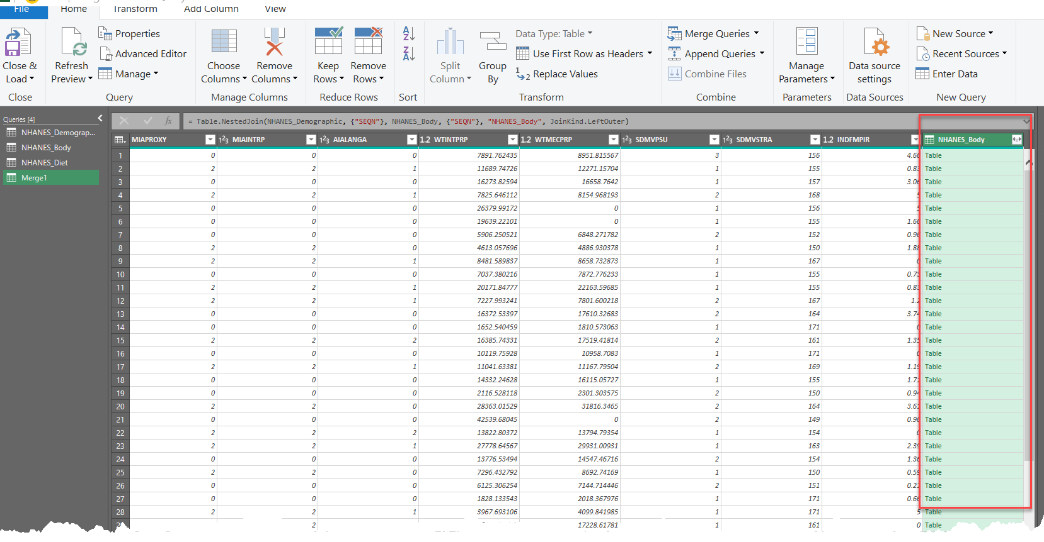
Notes:
The right-most column contains the data for the Body data frame. Click the icon next to the header to extract the columns for that data frame. Decide which variables you want included. To do this we go to the word file that describes the variables in the data frame.

Slide 33
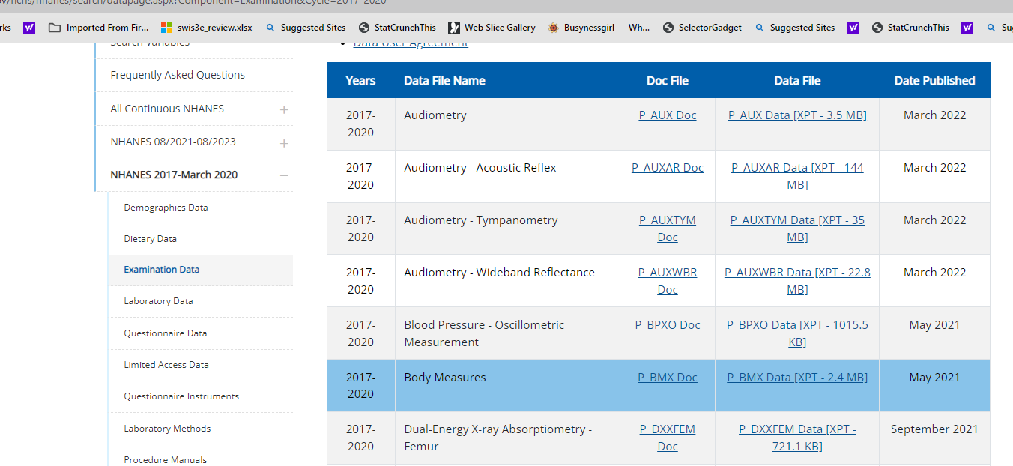
Notes:
Click P_BMX.Doc to open the data documentation and codebook.

Slide 34
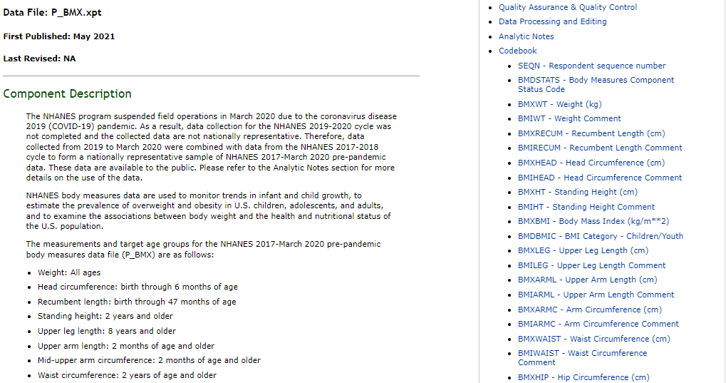

Slide 35
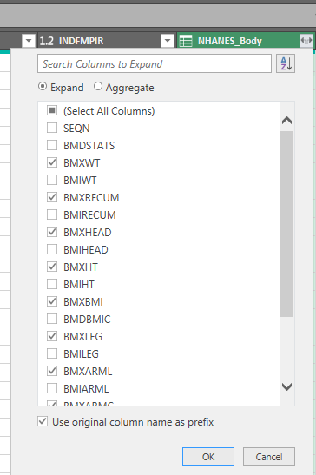
Notes:
Select the body measurements desired and click OK. Then, click Close and Load.

Slide 36
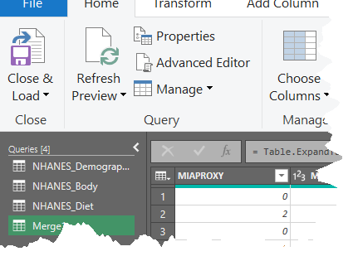
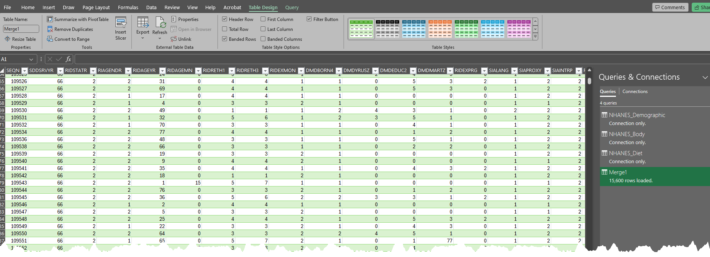
Notes:
Click Close and Load to create the data frame of the merged files. Repeat this process for the Diet data.

Slide 37
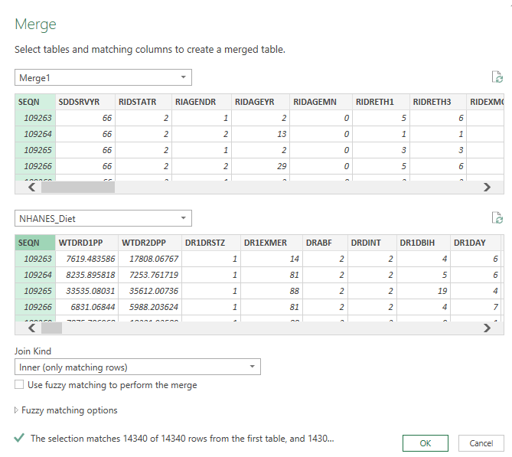
Notes:
Again we do inner matching. Click OK.

Slide 38
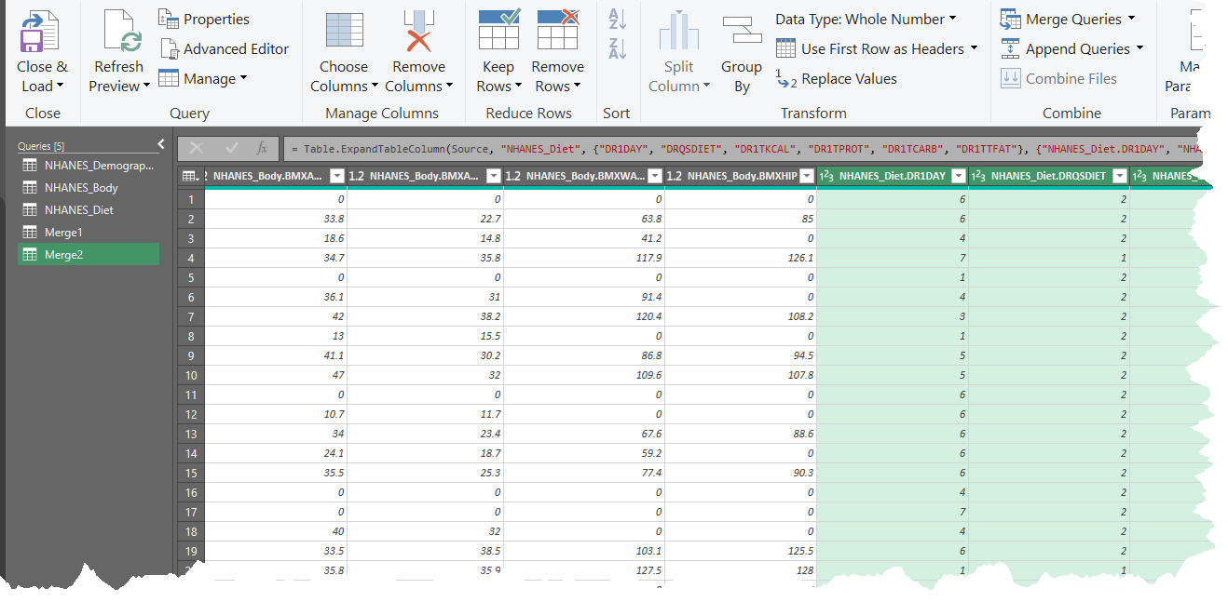
https://sullystats.github.io/Data/NHANES.csv
Notes:
Choose variables from the Diet Table. Click Close & Load. Save the file (NHANES_Webinar).

Slide 39
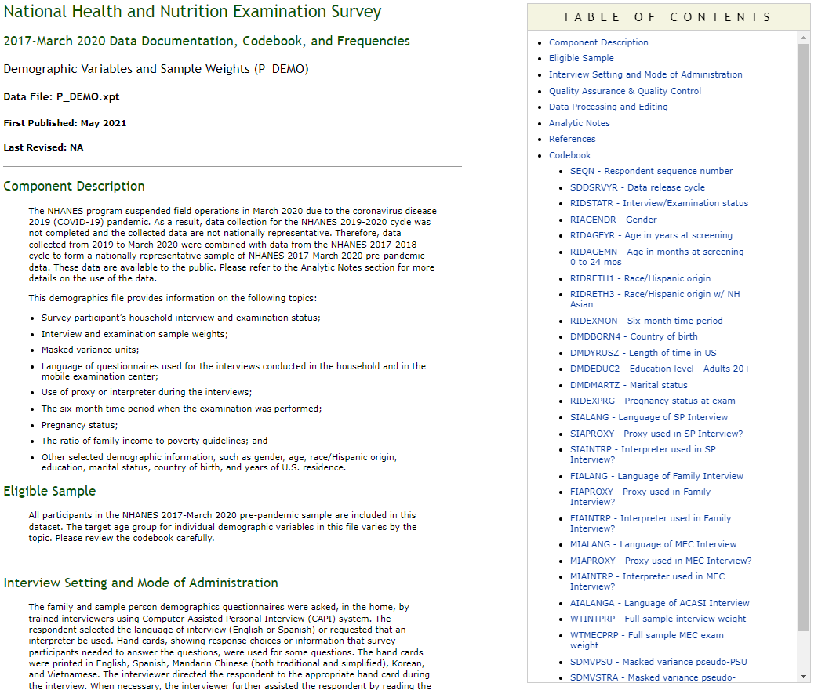
Notes:
Now we need to clean up the column heads for our variables by renaming the variables based on the codebook. We also may delete unwanted variables (such as data release cycle).

Slide 40
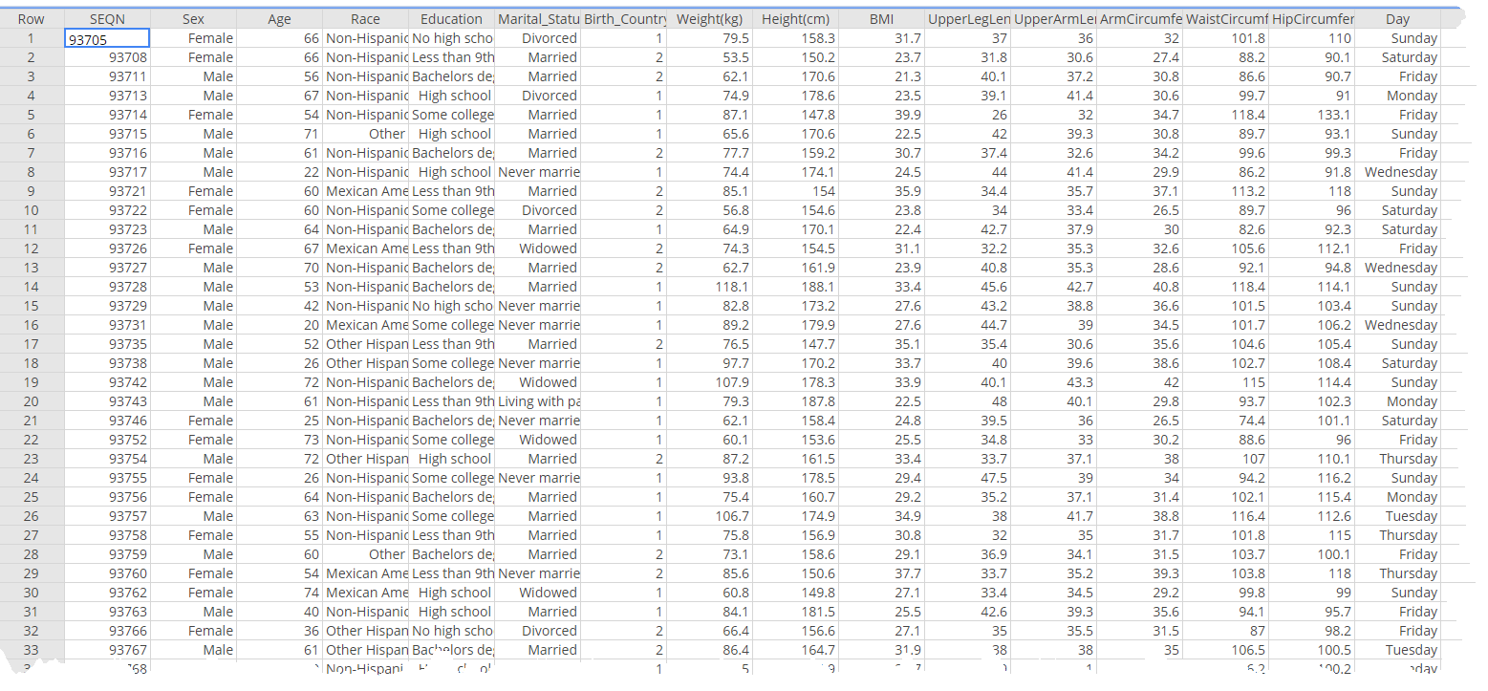
https://sullystats.github.io/Data/Health.csv
Notes:
Okay. Let’s use a different NHANES file that I have and answer a few questions.

Slide 41
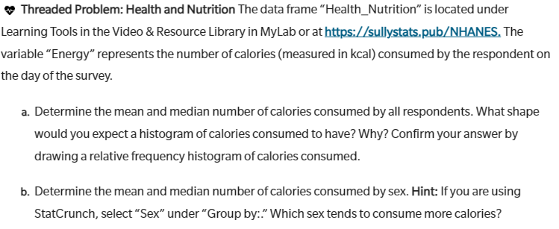

Slide 42
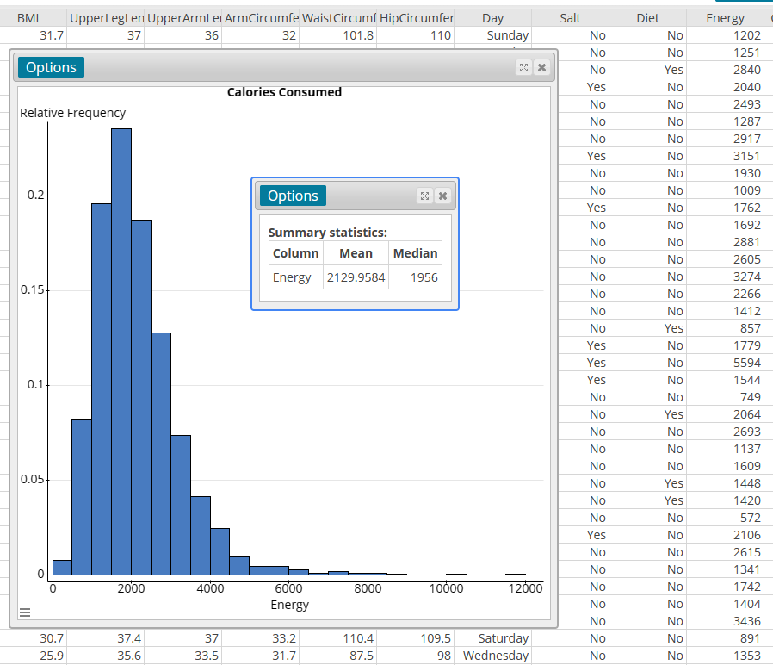
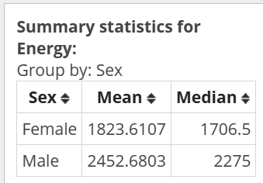

Slide 43
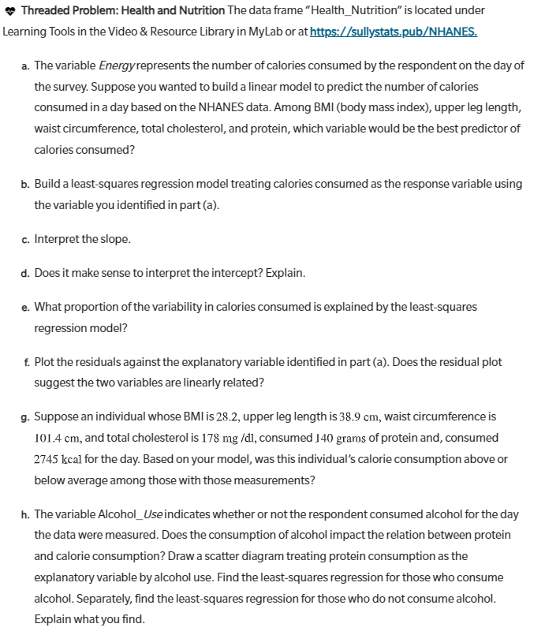

Slide 44
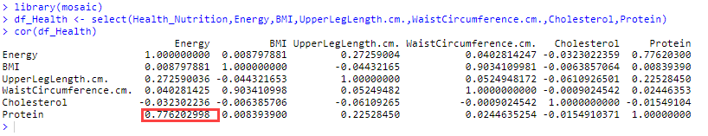
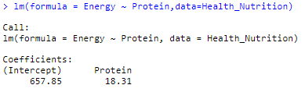

Slide 45
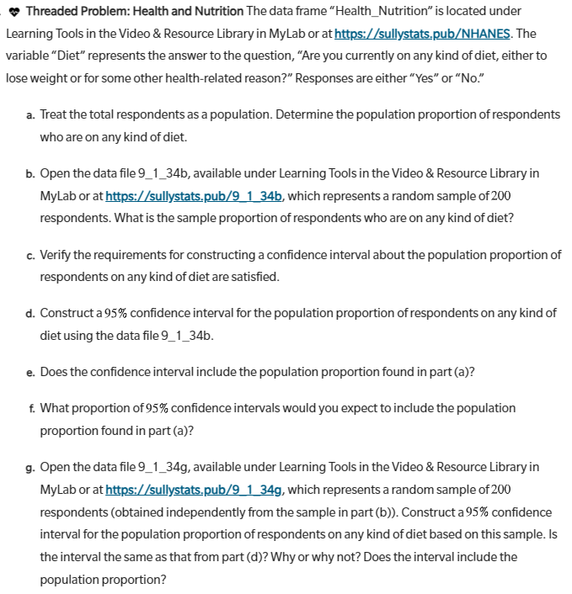

Slide 46
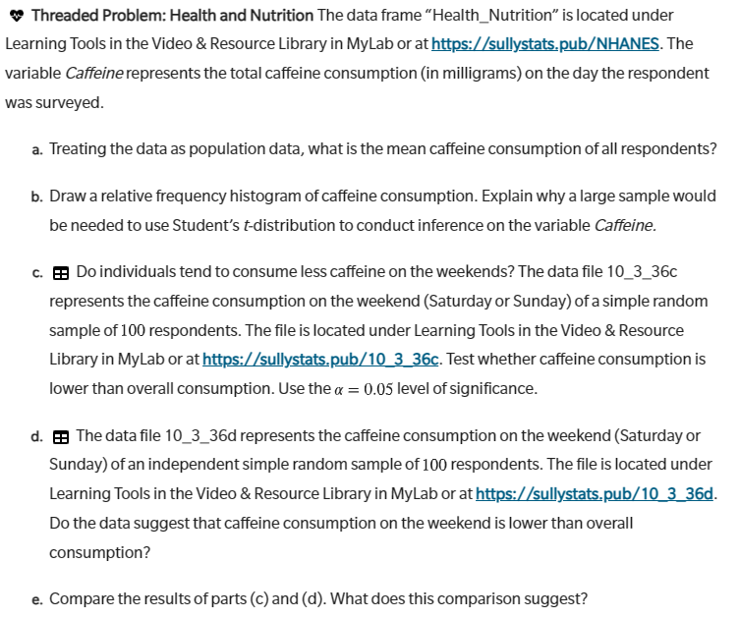

Slide 47
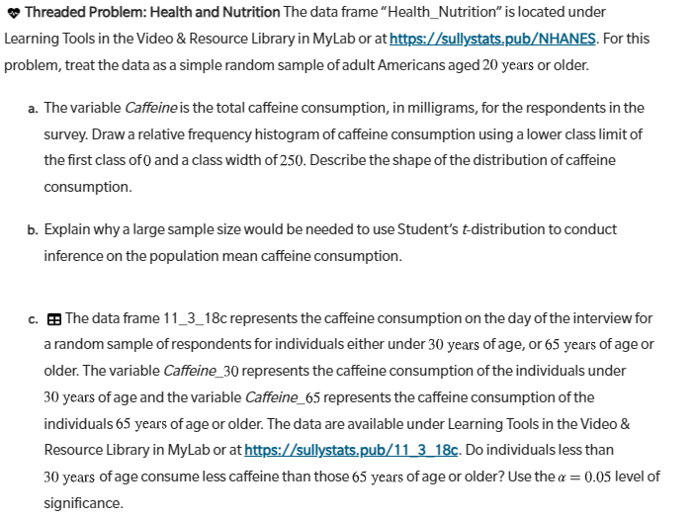

Slide 48
Building a Survey in StatCrunch
https://www.youtube.com/watch?v=SN-0WngXkgE
Notes:
StatCrunch is free to instructors. Folks taking the survey do not need a StatCrunch account.

Slide 49
Learning Catalytics
www.learningcatalytics.com
https://www.sullystats.com/video/

Slide 50
THANK YOU
Michael Sullivan​
sullystats@gmail.com
michael.sullivan@fsw.edu
https://www.sullystats.com

